Slide 1


















How LocalStack is recreating AWS with Python
…
://
Dr. Thomas Rausch
Co-Founder at LocalStack
>_
@thrauat
EuroPython 2023 Prague & Remote

Slide 2
LocalStack is
a platform for cloud application development and testing

Slide 3

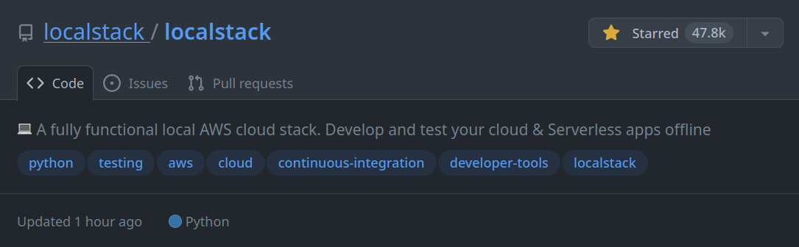
LocalStack is
an AWS emulator

Slide 4
LocalStack is
a drop-in replacement for AWS that runs on your local machine

Slide 5

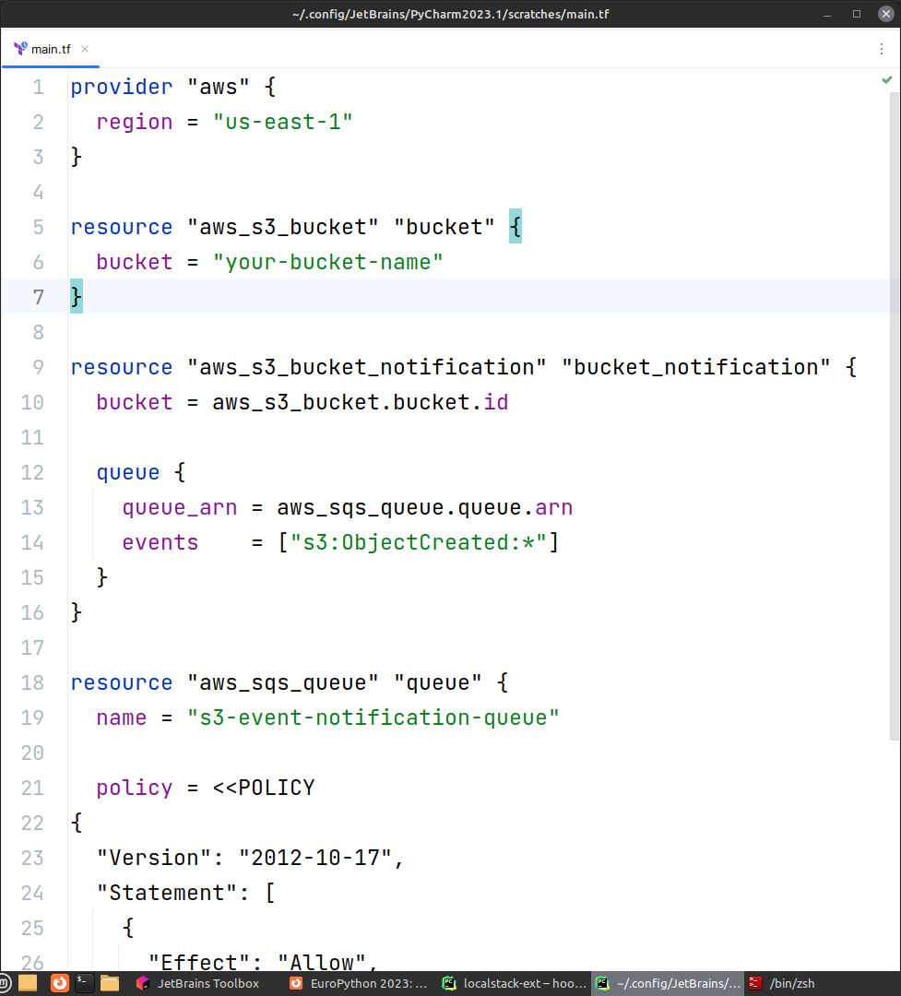
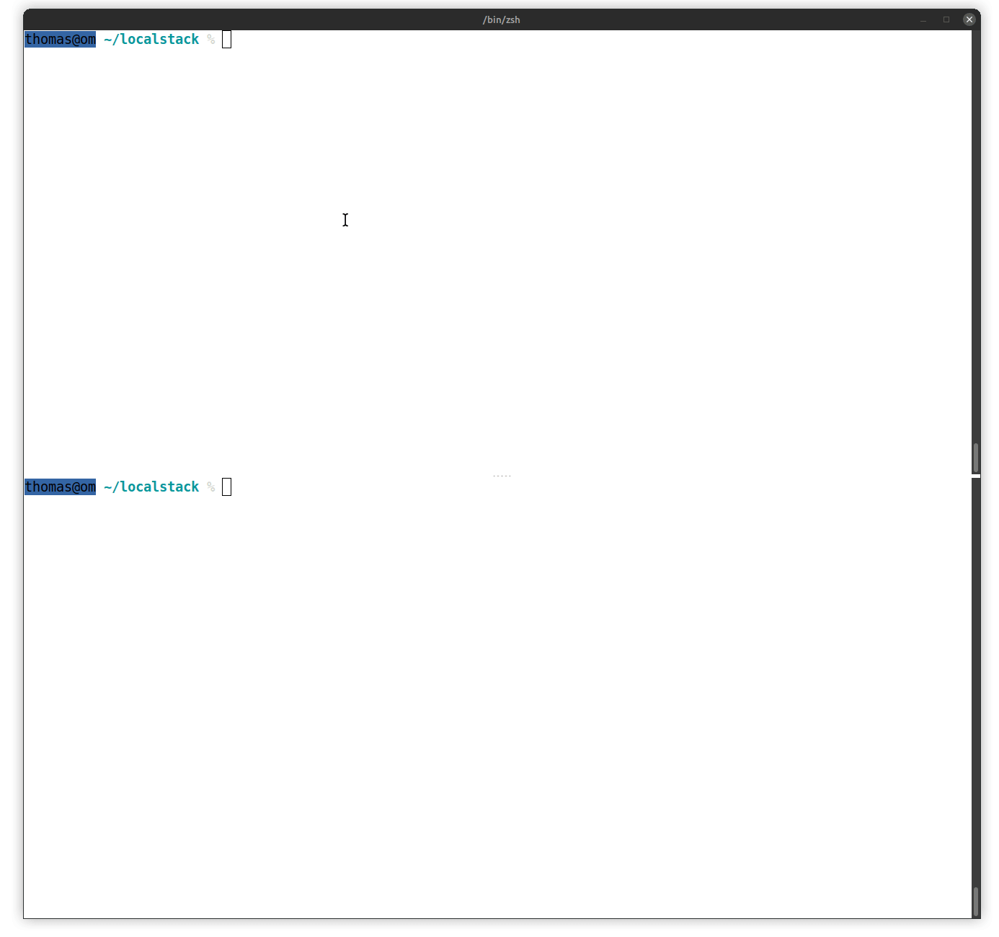
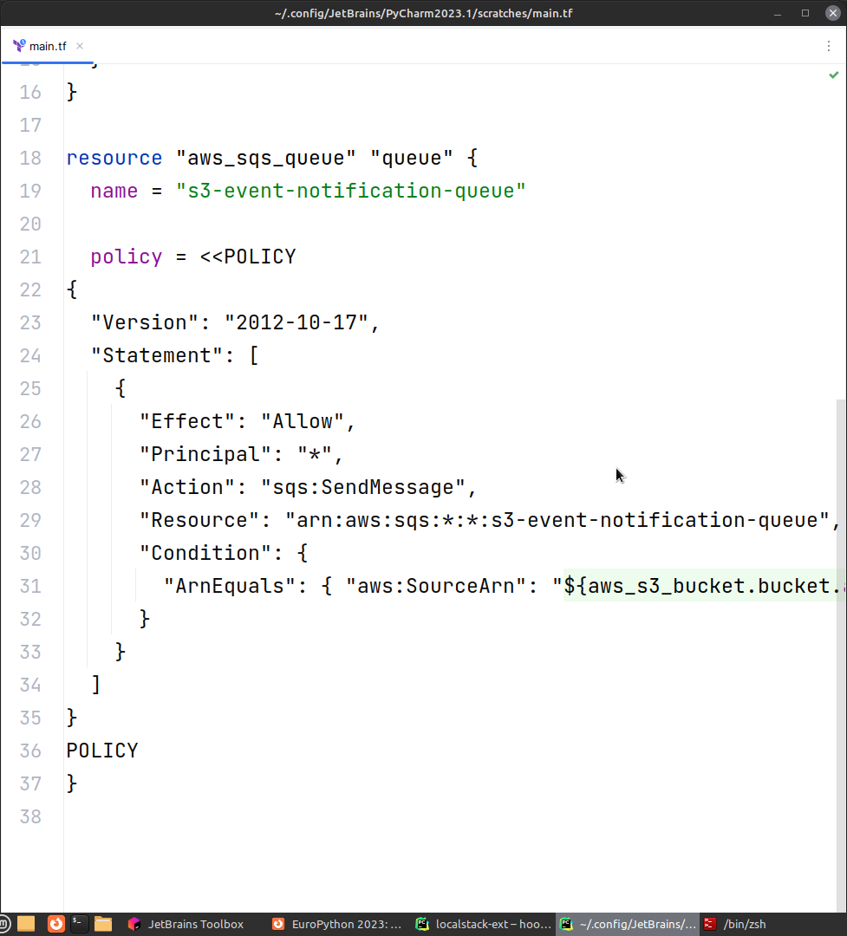

Slide 6
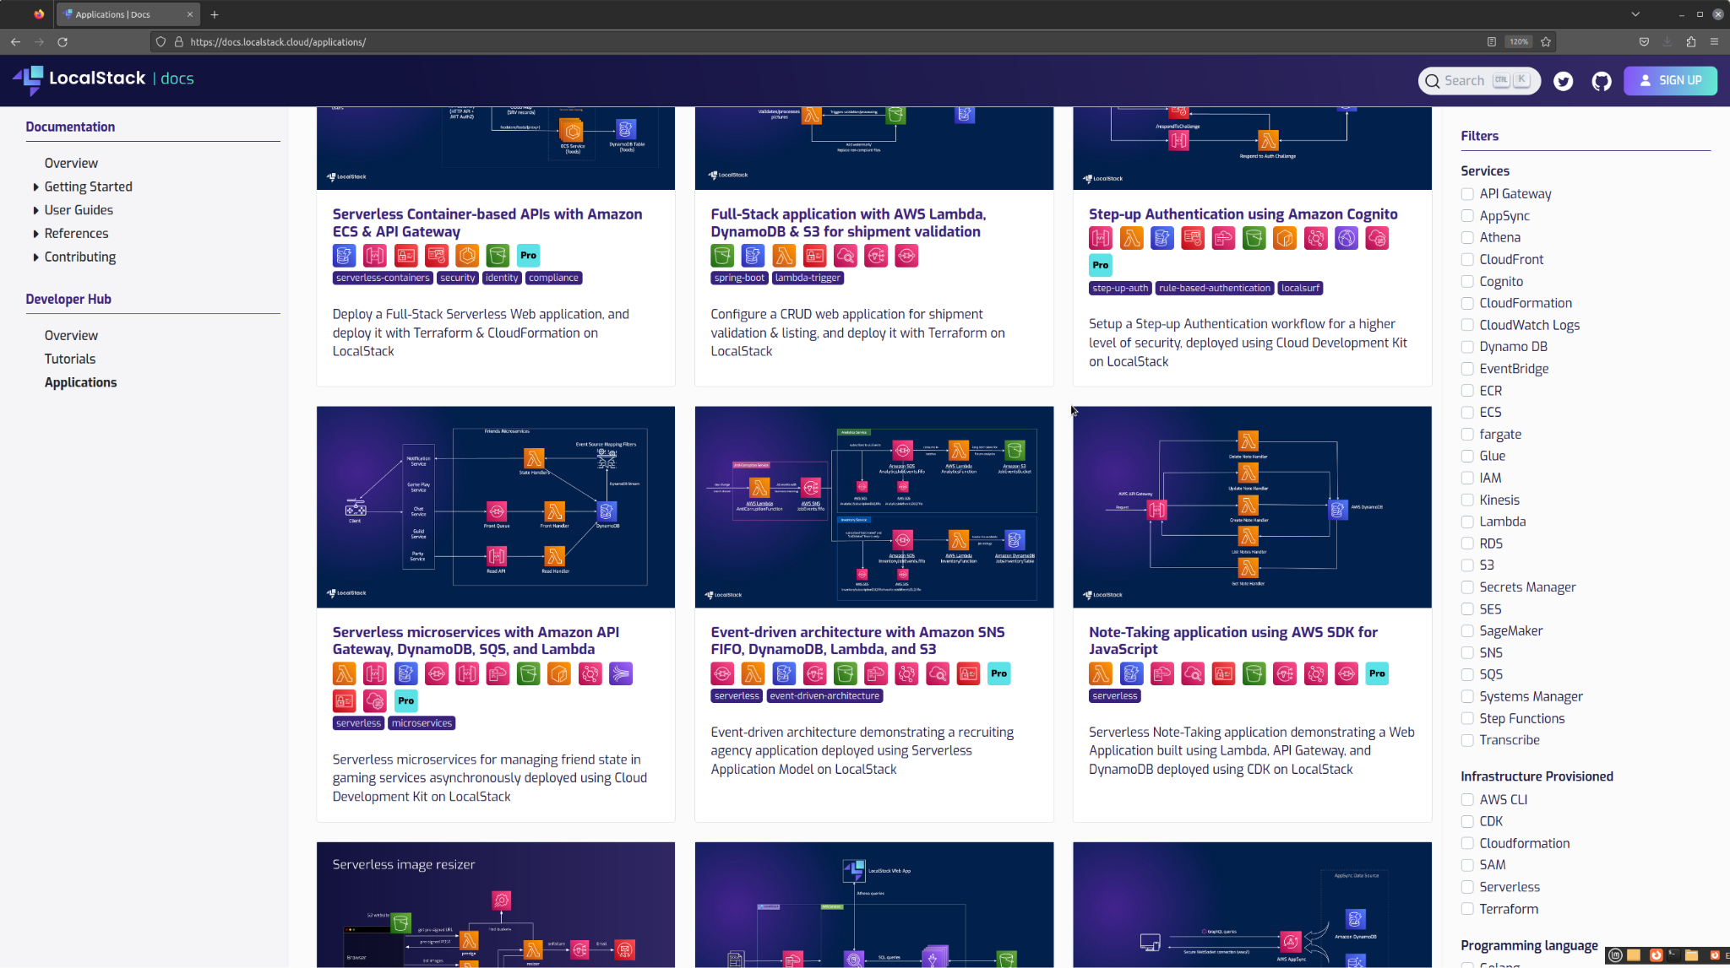
docs.localstack.cloud/applications

Slide 7
How do we do it?

Slide 8
How do we do it?
Use Python!

Slide 9
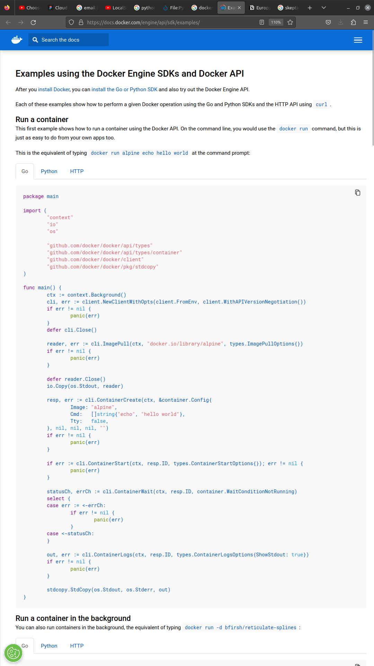

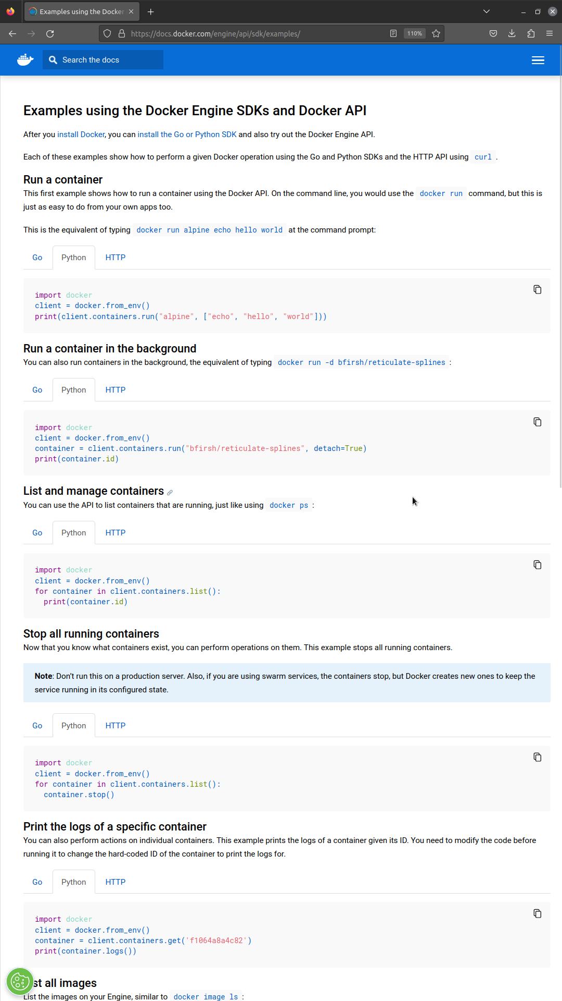
https://docs.docker.com/engine/api/sdk/examples/

Slide 10
How do we do it?
Use Python!
Reduce complexity

Slide 11
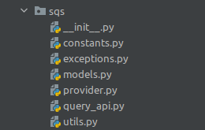
We can reduce complexity
Everything runs locally!
Fewer distributed system challenges
Example: full Python SQS implementation in ~2k LoC
class SqsQueue:
name: str
region: str
account_id: str
attributes: QueueAttributeMap
tags: TagMap
purge_in_progress: bool
purge_timestamp: Optional[float]
delayed: Set[SqsMessage]
inflight: Set[SqsMessage]
receipts: Dict[str, SqsMessage]

Slide 12
How do we do it?
Use Python!
Reduce complexity
Leverage the open source AWS ecosystem
Standardize the repeatable parts (service emulators)
Development
Testing
Maintenance
Embrace pluggability

Slide 13
Service emulators

Slide 14
Service emulators (how it used to be)

Slide 15
$ awslocal kinesis put-record ...
POST http://localhost:4566
class ProxyListenerKinesis(ProxyListener):
def forward_request(self, method, path, data, headers):
class ProxyListenerKinesis(ProxyListener):
def forward_request(self, method, path, data, headers):
data, encoding_type = self.decode_content(data or "{}", True)
action = headers.get("X-Amz-Target", "").split(".")[-1]
if action == "SubscribeToShard":
result = subscribe_to_shard(data, headers)
return result
if random.random() < config.KINESIS_ERROR_PROBABILITY:
if action in ["PutRecord", "PutRecords"]:
return kinesis_error_response(data, action, encoding_type)
if config.KINESIS_PROVIDER == "kinesalite":
return self.forward_request_kinesalite(
method, path, data, headers, action, encoding_type
)
return True
Edge Proxy
ProxyListenerKinesis
ProxyListenerSQS
ProxyListener …
mhart/ kinesalite
getmoto/ moto
…
Adding dev tool functionality
Notes:
Historically, LocalStack was conceived as a thin layer around third-party tools. So LocalSack would pull in existing AWS service emulators like kinesalite or moto, and just add a bit
The interface was very flexible, but also very rudimentary

Slide 16
$ awslocal sqs create-queue ...
POST http://localhost:4566
class ProxyListenerSQS(PersistingProxyListener):
def forward_request(self, method, path, data, headers):
if method == "OPTIONS":
return 200
req_data = parse_request_data(method, path, data)
if req_data:
action = req_data.get("Action")
if action == "CreateQueue":
req_data = self.fix_missing_tag_values(req_data)
changed_attrs = _fix_dlq_arn_in_attributes(req_data)
if changed_attrs:
return _get_attributes_forward_request(
method, path, headers, req_data,
)
elif action == "DeleteQueue":
queue_url = _queue_url(path, req_data, headers)
QUEUE_ATTRIBUTES.pop(queue_url, None)
sns_listener.unsubscribe_sqs_queue(queue_url)
elif action == "SetQueueAttributes":
queue_url = _queue_url(path, req_data, headers)
if SQS_BACKEND_IMPL == "elasticmq":
forward_attrs = _set_queue_attributes(queue_url, req_data)
if len(req_data) != len(forward_attrs):
return _get_attributes_forward_request(
method, path, headers, req_data, forward_attrs
) ...
Edge Proxy
ProxyListenerKinesis
ProxyListenerSQS
ProxyListener …
mhart/ kinesalite
getmoto/ moto
…
Growing number of service integrations

Slide 17

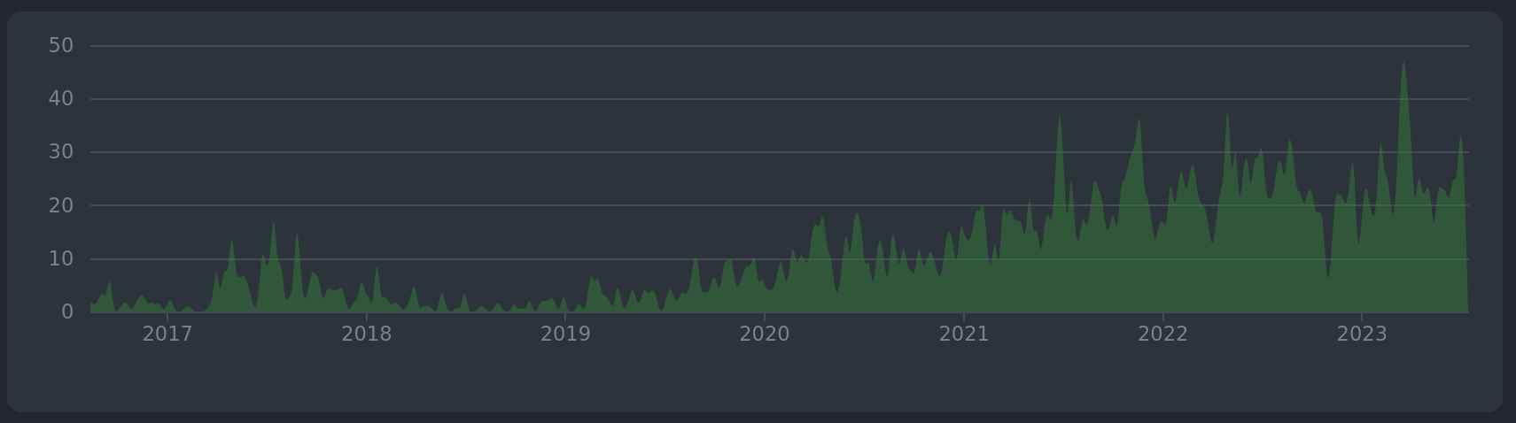
Contributors
Commits

Slide 18
Service emulators (how it’s now)

Slide 19
Leveraging AWS open source tools

Slide 20



{
"version":"2.0",
"metadata":{
"apiVersion":"2012-11-05",
"endpointPrefix":"sqs",
"protocol":"query",
"serviceAbbreviation":"Amazon SQS", ...
},
"operations":{
"AddPermission":{"name":"AddPermission"...},
"CreateQueue":{
"name":"CreateQueue",
"http":{
"method":"POST",
"requestUri":"/"
},
"input":{"shape":"CreateQueueRequest"},
"output":{
"shape":"CreateQueueResult",
"resultWrapper":"CreateQueueResult"
},
"errors":[
{"shape":"QueueDeletedRecently"},
{"shape":"QueueNameExists"}
],
...
from botocore.model import ServiceModel, OperationModel
from localstack.aws.spec import load_service
def print_sqs_operations():
service: ServiceModel = load_service("sqs")
for operation_name in service.operation_names:
operation: OperationModel operation = service.operation_model(operation_name)
print(
operation.name,
operation.input_shape.name,
operation.output_shape.name,
)
https://github.com/boto/botocore/blob/develop/botocore/data/sqs/2012-11-05/service-2.json

Slide 21
def generate_code(service_name: str) -> str:
model: ServiceModel = load_service(service_name)
output = io.StringIO()
generate_service_types(output, model)
generate_service_api(output, model)
code = output.getvalue()
import autoflake
import isort
import black
# try to remove unused imports
code = autoflake.fix_code(code, remove_all_unused_imports=True)
# try to format with black
code = black.format_str(code, mode=black.FileMode(line_length=100))
# try to sort imports
code = isort.code(code, config=isort.Config(profile="black", line_length=100))
return code

Slide 22
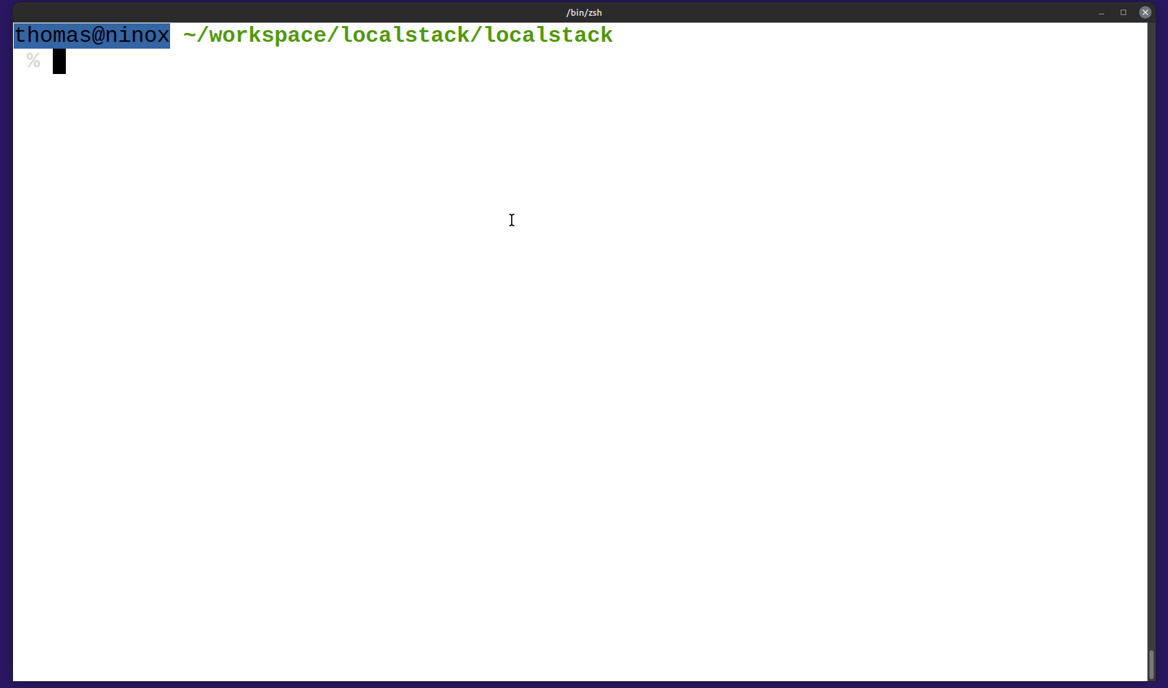

Slide 23
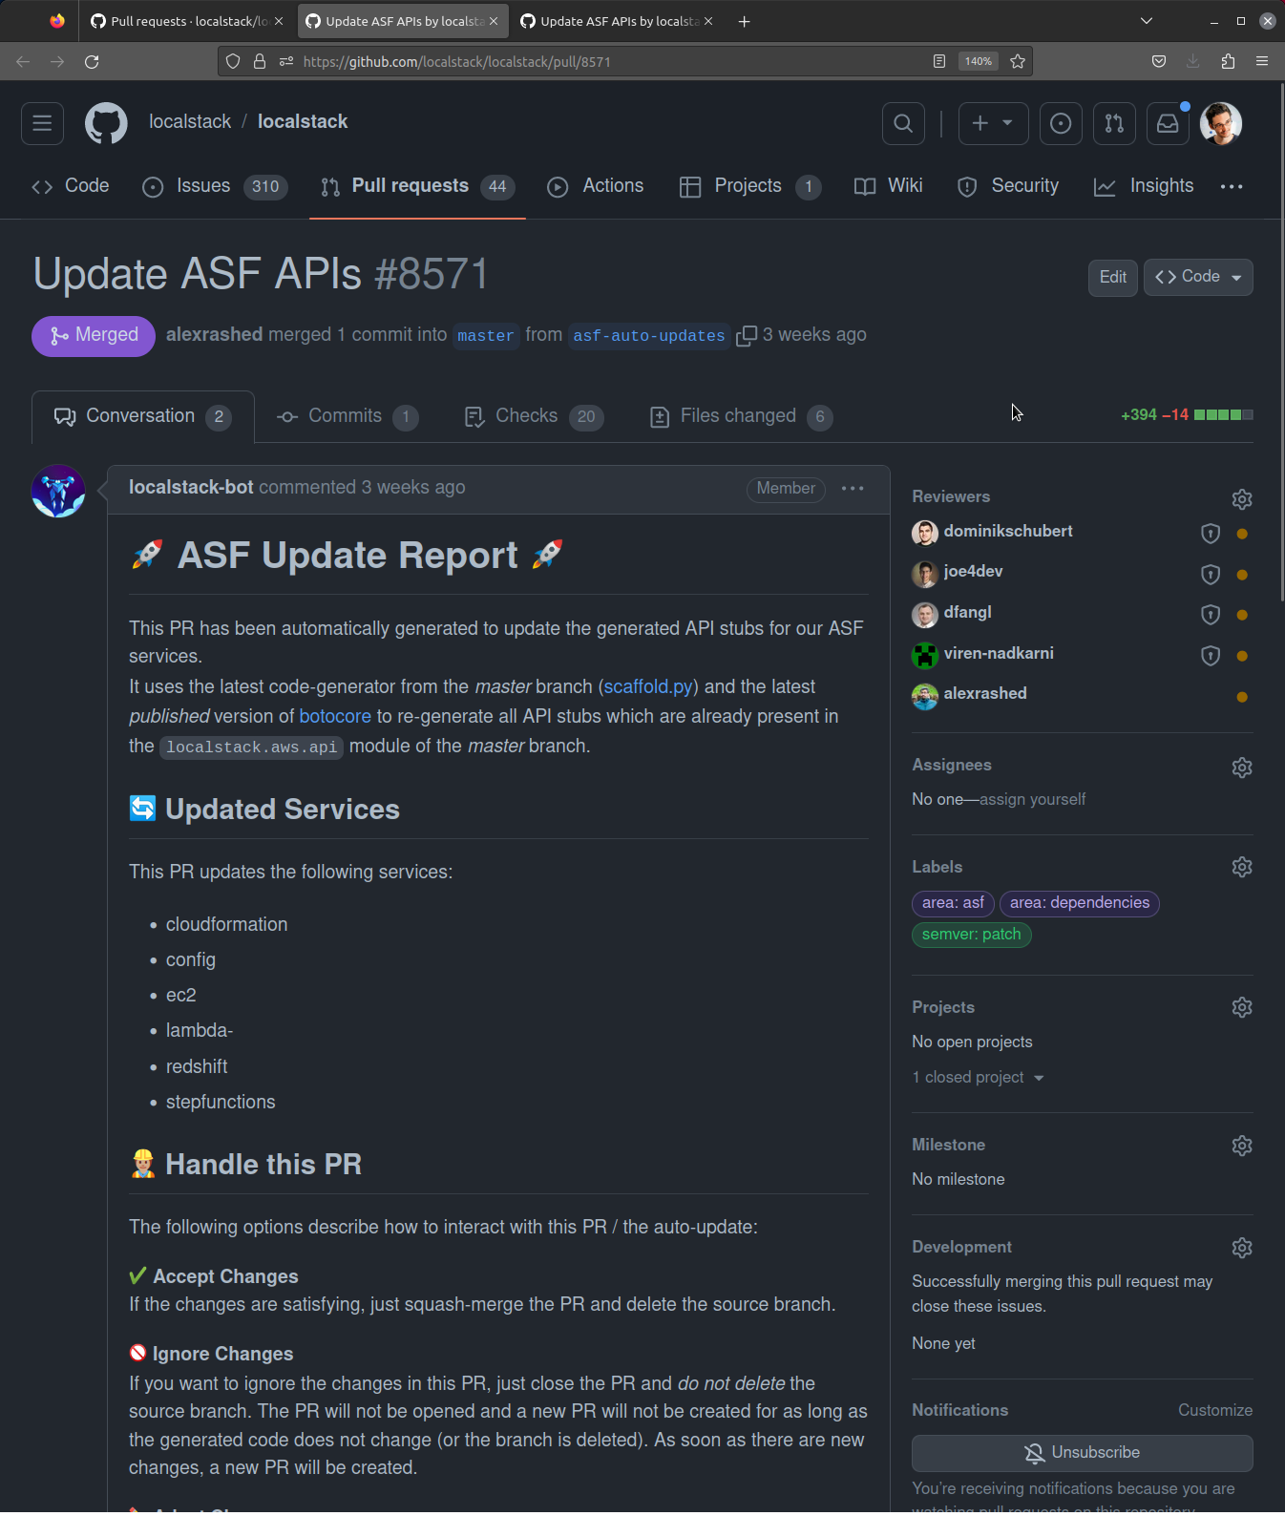
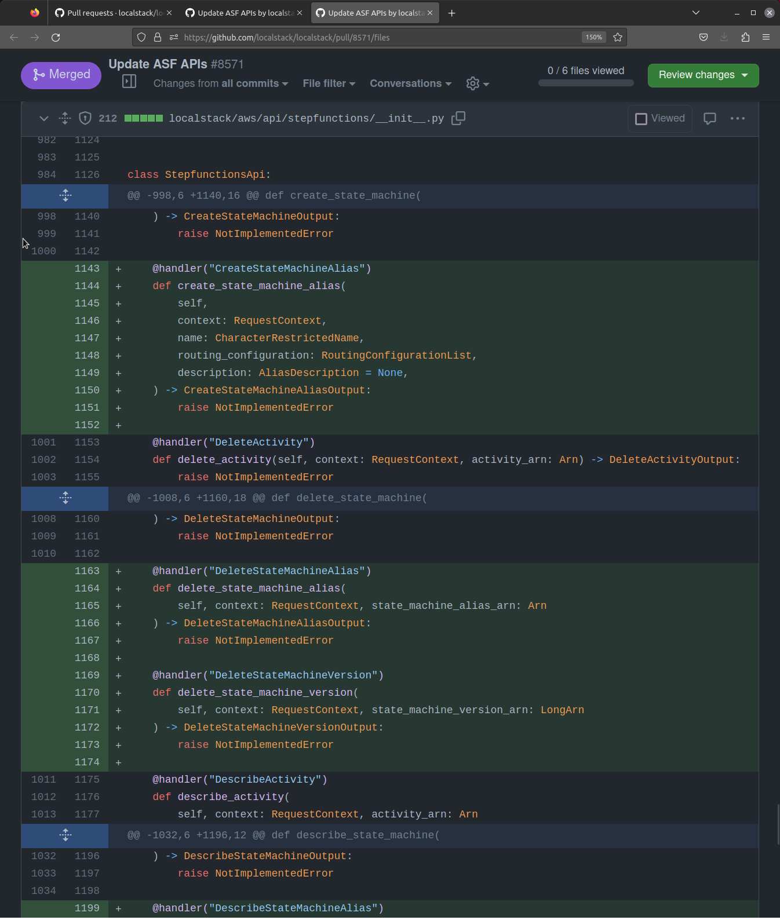

Slide 24
350 services
13,708 API operations
80 MB JSON specs
LocalStack: 93 services (and growing)

Slide 25

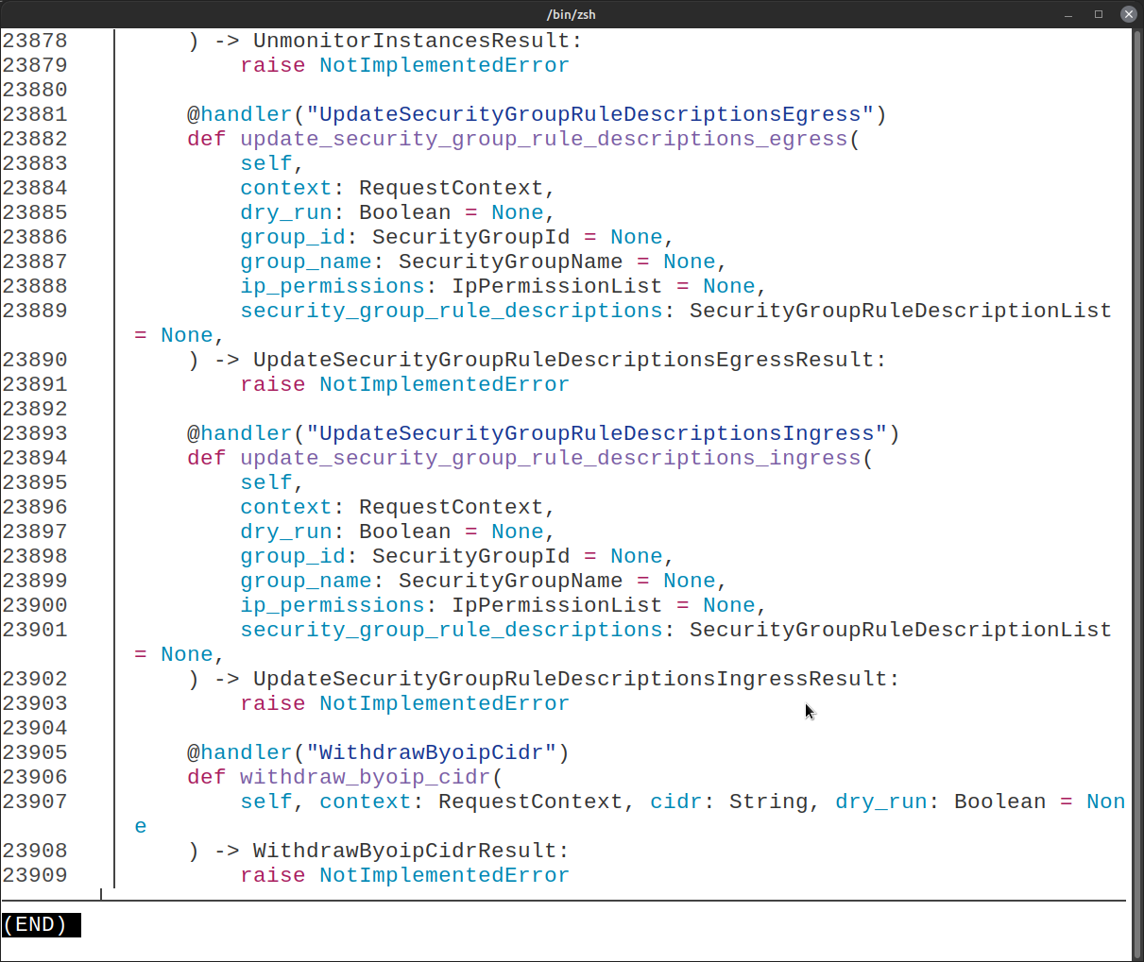
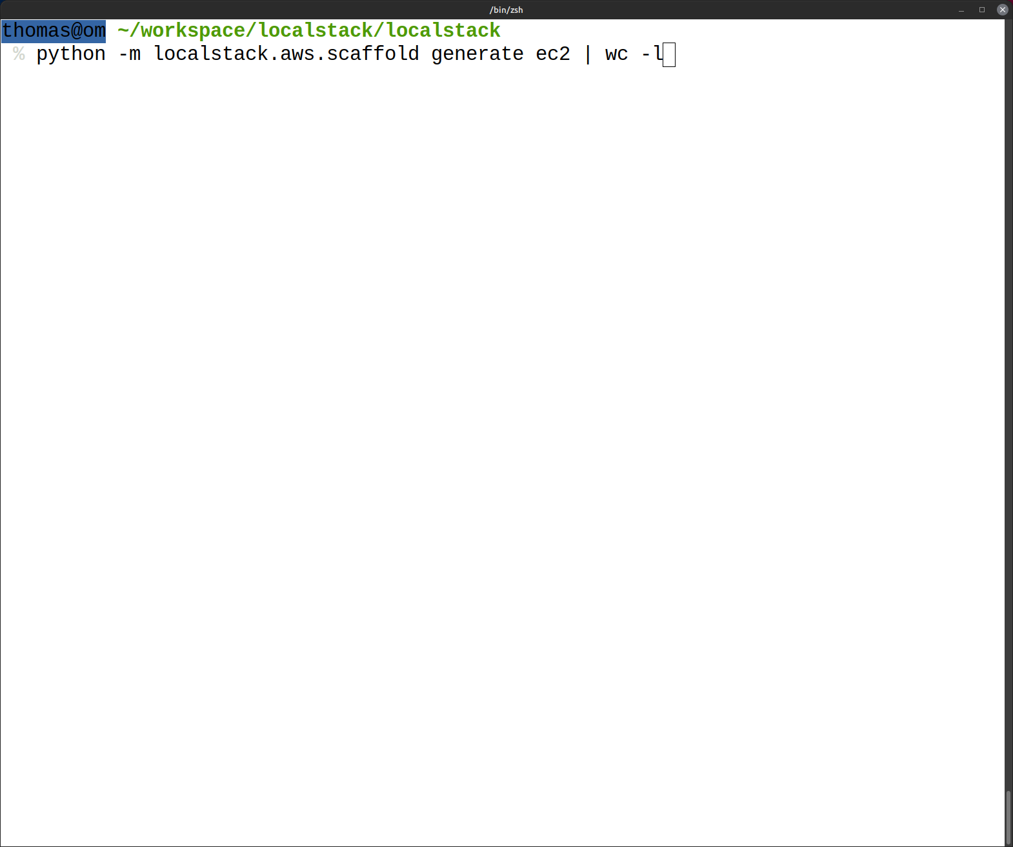

23909 lines

Slide 26
class SqsApi:
service = "sqs"
version = "2012-11-05"
@handler("CreateQueue")
def create_queue(
self,
context: RequestContext,
queue_name: String,
attributes: QueueAttributeMap = None,
tags: TagMap = None,
) -> CreateQueueResult:
raise NotImplementedError
API Stub
Examples:
RDS: PostgreSQL, MariaDB, …
ElastiCache: Redis
MSK: Kafka
MQ: ActiveMQ
OpenSearch: OpenSearch
…
class ActiveMQPackage(Package):
def __init__(self):
super().__init__("ActiveMQ", "5.16.6")
def get_versions(self) -> List[str]:
return ["5.16.6"]
def _get_installer(self, version: str) -> PackageInstaller:
return ActiveMQPackageInstaller("active-mq", version)
implements
class SqsProvider(SqsApi):
@handler("CreateQueue")
def create_queue(
self,
context: RequestContext,
queue_name: String,
attributes: QueueAttributeMap = None,
tags: TagMap = None,
) -> CreateQueueResult:
fifo = attributes.get(QueueAttributeName.FifoQueue)
queue = SqsQueue(...) # ...
Implementation
uses or provides
Backend Service
Backend Service
Backend Service

Slide 27
Open AWS container tools

Slide 28
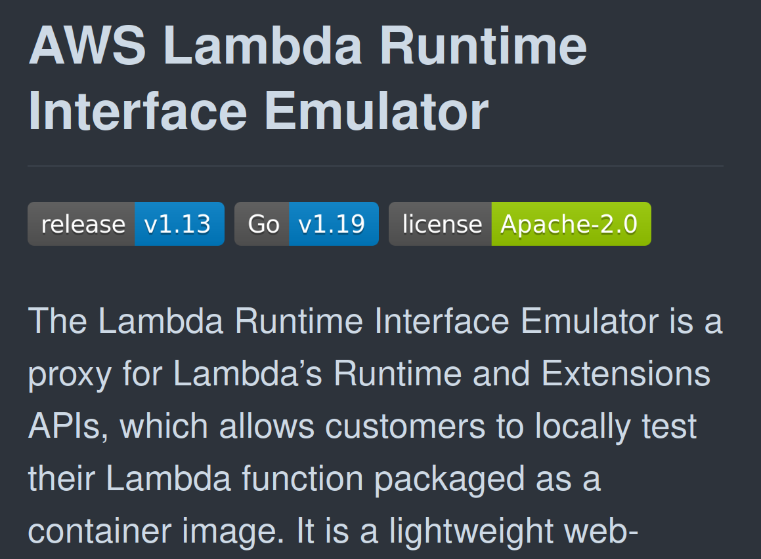


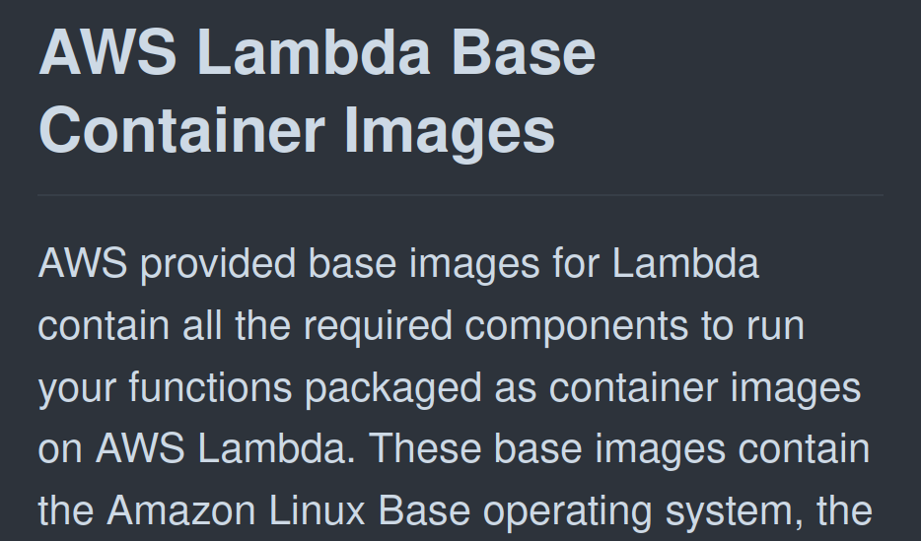
Example: Lambda
S3 Provider
$ awslocal lambda invoke \
--function-name my-function
Lambda Provider
my-function
Proxy
RIE
POST /functions/ my-function/invoke
lambda/python:3.10
/var/run/docker.sock

Slide 29
LocalStack’s Web Application Framework

Slide 30


ASGI/WSGI Bridge
LocalStack Framework
Request Response
class RequestContext:
request: Request
service: Optional[ServiceModel]
operation: Optional[OperationModel]
# ...
HTTP 2 Server
ASGI Adapter
Gateway
chain.handle(RequestContext, Response)
HandlerChain
Exception Handler
Exception Handler
GET /
Authorization: … ?Action=ListQueues
chain.stop() chain.throw(..)
handler.call( HandlerChain,RequestContext,Response
)
Request Handler
Response Handler
Request Handler
Request Handler
Request Handler
Request Handler

Slide 31
class ServiceNameParser(Handler):
def __call__(self, chain: HandlerChain, context: RequestContext, response: Response):
service = determine_aws_service_name(context.request)
if not service:
return
context.service = self.get_service_model(service)
def get_service_model(self, service: str) -> ServiceModel:
return load_service(service)
class ServiceRequestParser(Handler):
parsers: Dict[str, RequestParser]
def __init__(self):
self.parsers = dict()
def __call__(self, chain: HandlerChain, context: RequestContext, response: Response):
if not context.service:
LOG.debug("no service set in context, skipping request parsing")
return
return self.parse_and_enrich(context)
def get_parser(self, service: ServiceModel):
name = service.service_name
if name in self.parsers:
return self.parsers[name]
self.parsers[name] = create_parser(service)
return self.parsers[name] ...

Slide 32
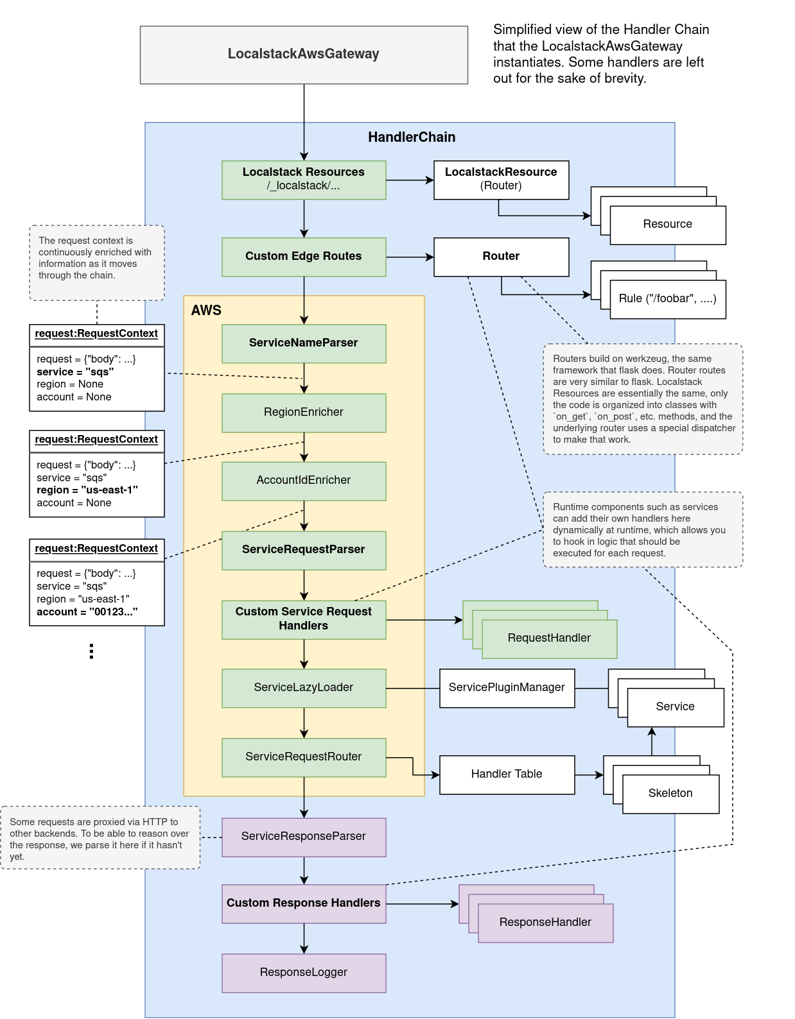
class LocalstackAwsGateway(Gateway):
def __init__(self, service_manager: ServiceManager = None) -> None:
super().__init__()
self.service_manager = service_manager or ServicePluginManager()
self.service_request_router = ServiceRequestRouter()
# lazy-loads services into the router
load_service = ServiceLoader()
# the main request handler chain
self.request_handlers.extend(
[
handlers.push_request_context,
handlers.preprocess_request,
handlers.parse_service_name,
handlers.enforce_cors,
handlers.content_decoder,
handlers.serve_localstack_resources,
handlers.serve_default_listeners,
handlers.serve_edge_router_rules,
# start aws handler chain
handlers.inject_auth_header_if_missing,
handlers.add_region_from_header,
handlers.add_account_id,
handlers.add_internal_request_params,
handlers.parse_service_request,
handlers.serve_custom_service_request_handlers,
load_service,
self.service_request_router,
# if the chain is still running, set an empty response
EmptyResponseHandler(404, b'{"message": "Not Found"}'),
]
)
# exception handlers in the chain
self.exception_handlers.extend(
[
handlers.log_exception,
handlers.handle_service_exception,
handlers.handle_internal_failure,
]
)
# ...

Slide 33
class HandlerToListenerAdapter(ProxyListener):
chain: HandlerChain
def forward_request(self, method, path, data, headers):
context = RequestContext()
context.request = create_request_from_parts(method, path, data, headers)
response = Response()
self.chain.handle(context, response)
return response
class ListenerToHandlerAdapter(Handler):
listener: ProxyListener
def __call__(self, chain: HandlerChain, context: RequestContext, response: Response):
request = context.request
result = self.listener.forward_request(
method=request.method,
path=request.full_path if request.query_string else request.path,
data=restore_payload(request),
headers=request.headers,
)
if type(result) == int:
chain.respond(status_code=result)
return
if isinstance(result, ...)
# ...
raise ValueError(f"cannot create response for result {result}")

Slide 34


Slide 35
Pluggability

Slide 36
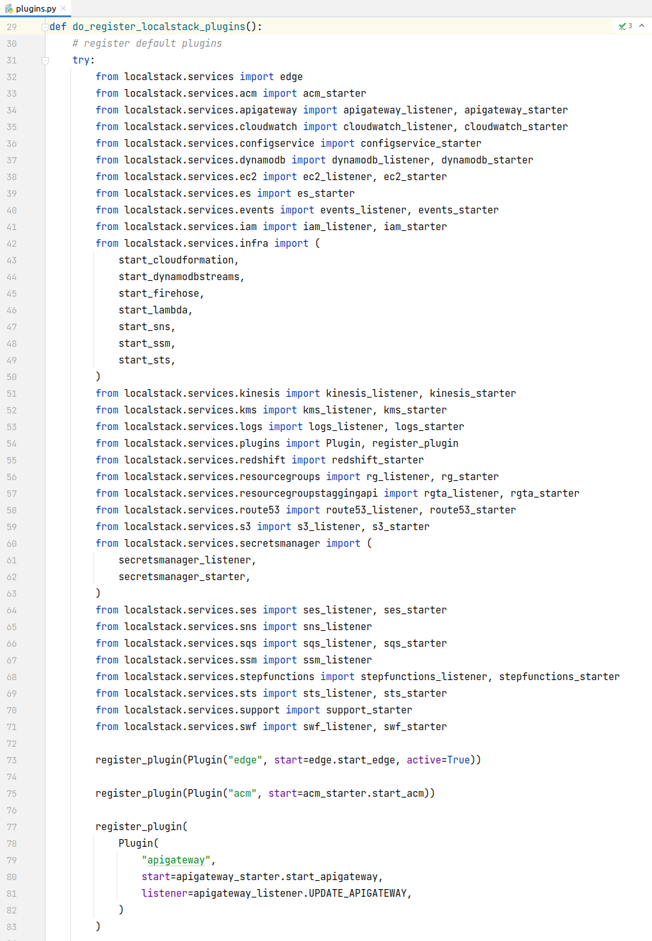
import
Took 5+ seconds
No way to discover unknown packages
… all the other obvious problems

Slide 37

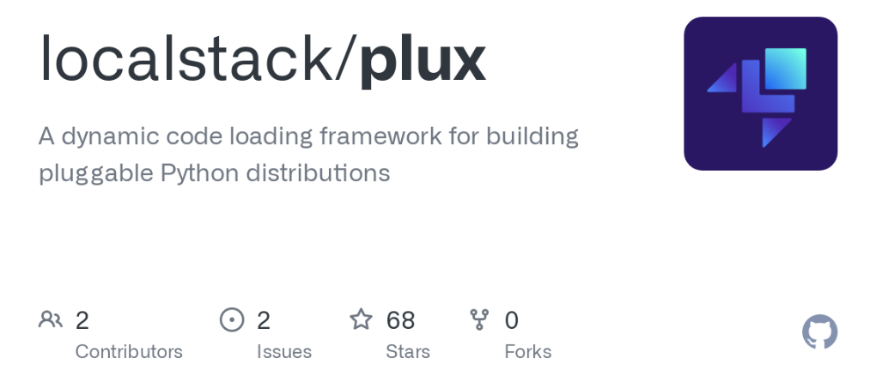
from plugin import plugin
@plugin(namespace="localstack.configurators")
def configure_logging(runtime):
logging.basicConfig(level=runtime.config.loglevel)
@plugin(namespace="localstack.configurators")
def configure_something(runtime):
# defer imports to here and do something
localstack core
localstack ext
extensions
extensions
extensions
plux builds
egg-info/entry_points.txt
[localstack.configurators]
configure_logging = localstack.plugins::configure_logging configure_something = localstack.plugins::configure_something
plux loads entry points as plugins
from plugin import PluginManager
plugins = PluginManager("localstack.configurators")
runtime = LocalstackRuntime()
for configurator in plugins.load_all():
configurator(runtime)

Slide 38

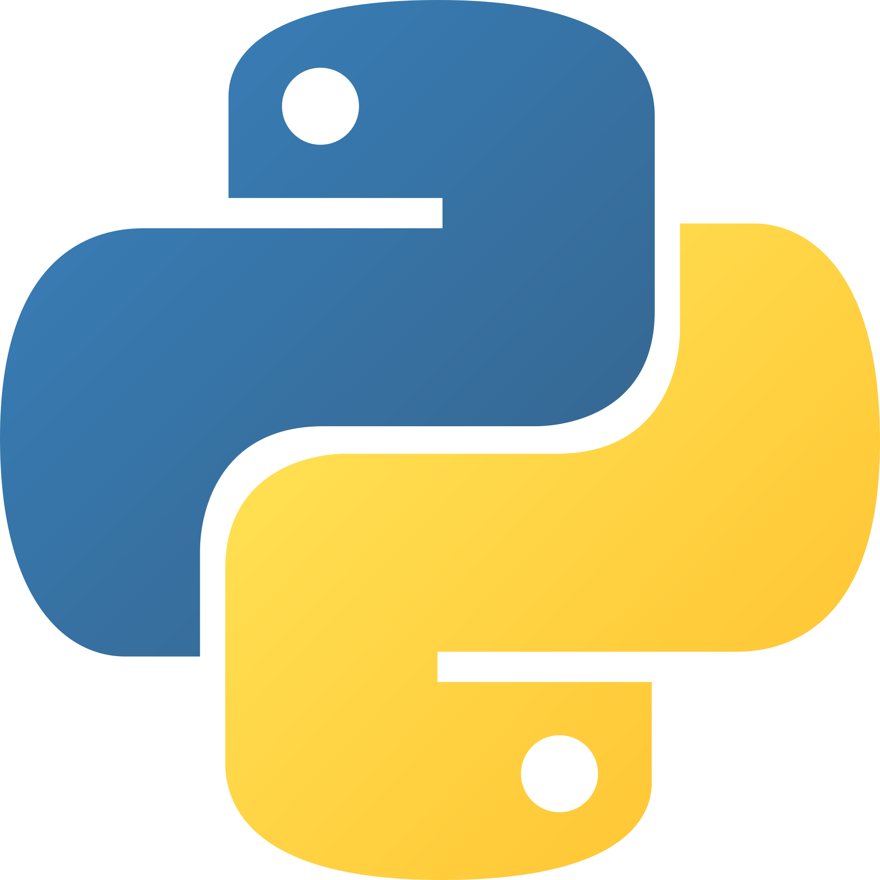



from localstack.extensions.api import Extension
class MyExtension(Extension):
name = "my-extension"
def on_platform_start(self):
# run when localstack starts up
pass
def on_platform_ready(self):
# run when localstack runtime is ready
pass
def update_gateway_routes(self, router: Router):
# add additional HTTP routes
pass
def update_request_handlers(self, handlers: ...):
# add AWS request handlers
pass
def update_response_handlers(self, handlers: ...):
# add AWS response handlers
pass
Service
Provider
Runtime Hooks
Gateway Router
Extension
:4566
volume
AWS
Client
Extension

Slide 39
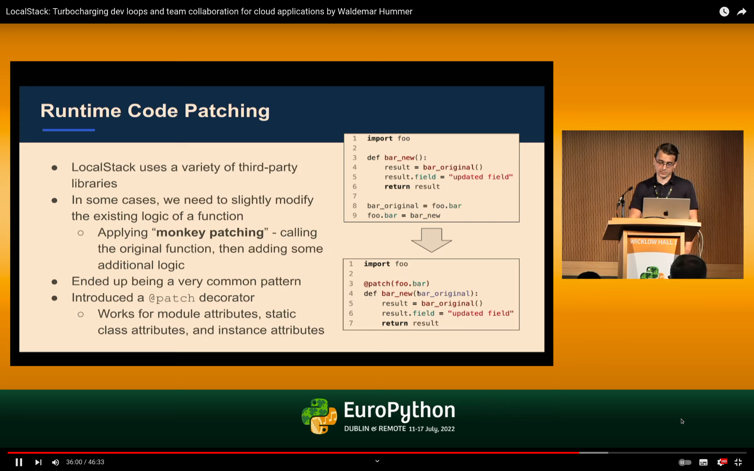
https://www.youtube.com/watch?v=YIkKsnxb9eE

Slide 40
Parity

Slide 41
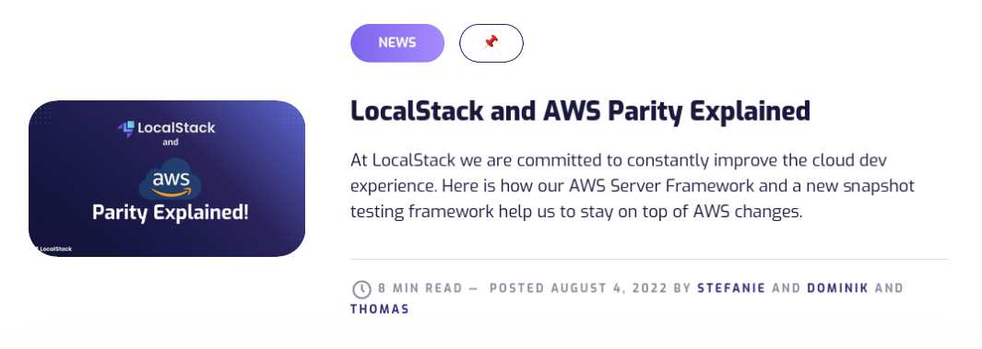
https://localstack.cloud/blog/2022-08-04-parity-explained

Slide 42

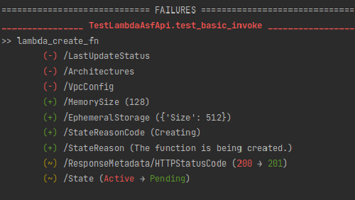
Parity testing
{
"test_lambda_api.py::TestLambda::test_basic_invoke": {
"recorded-date": ...,
"recorded-content": {
"lambda_create_fn": {
"ResponseMetadata": {
"HTTPStatusCode": 201,
"HTTPHeaders": {}
},
"FunctionName": "<function-name:1>",
"FunctionArn": "arn:aws:lambda:<region>:111111111111:function:<function-name:1>",
"Runtime": "python3.9",
"Role": "arn:aws:iam::111111111111:role/<resource:1>",
"Handler": "index.handler",
"CodeSize": 276,
"Description": "",
"Timeout": 3,
"MemorySize": 128,
"LastModified": "date",
"CodeSha256": "zMYxuJ0J/jyyHt1fYZUuOqZ/Gc9Gm64Wp8fT6XNiXro=",
"Version": "$LATEST",
"TracingConfig": {
"Mode": "PassThrough"
},
"RevisionId": "<uuid:1>",
"State": "Pending",
"StateReason": "The function is being created.",
"StateReasonCode": "Creating",
"PackageType": "Zip",
"Architectures": [
"x86_64"
],
"EphemeralStorage": {
"Size": 512
}
},
"lambda_invoke_result": {
"ResponseMetadata": {
"HTTPStatusCode": 200,
"HTTPHeaders": {}
},
"StatusCode": 200,
"ExecutedVersion": "$LATEST",
"Payload": {}
}
}
}
}
def test_basic_invoke(
lambda_client, create_lambda, snapshot
):
# custom transformers
snapshot.add_transformer(snapshot.transform.lambda_api())
# predefined name
fn_name = f"ls-fn-{short_uid()}"
# create the function
response = create_lambda(FunctionName=fn_name, ...)
# record the response as part of the snapshot
snapshot.match("lambda_create_fn", response)
# invoke function
invoke_result = lambda_client.invoke(
FunctionName=fn_name,
Payload=bytes("{}", "utf-8")
)
snapshot.match("lambda_invoke_result", invoke_result)
Cloud Provider

Slide 43
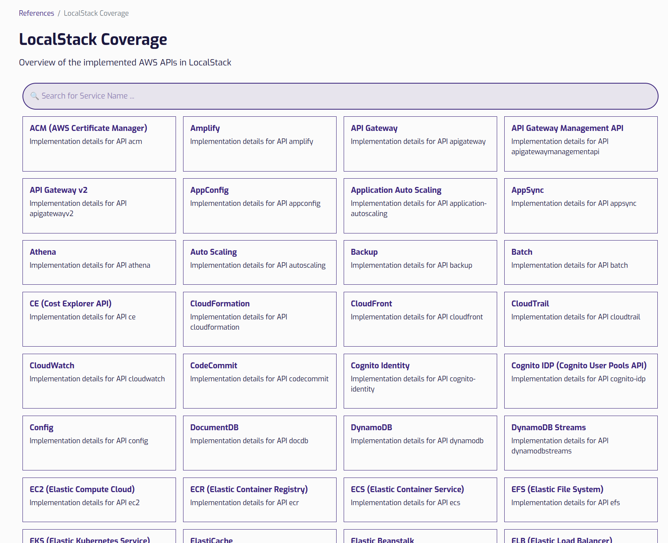
https://docs.localstack.cloud/references/coverage/

Slide 44
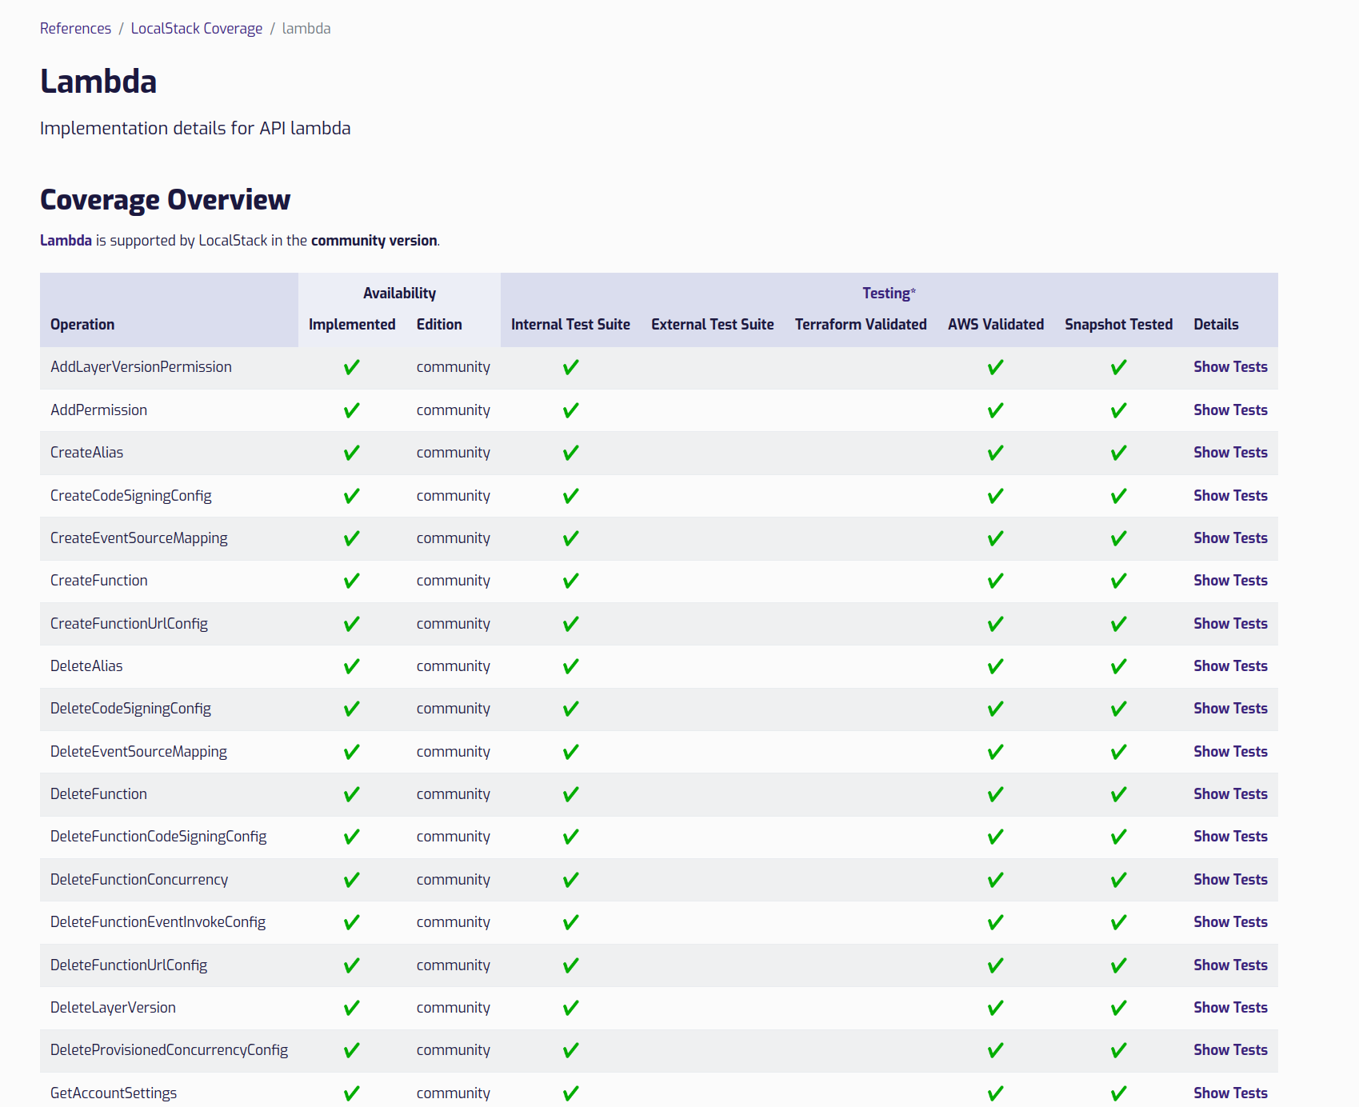
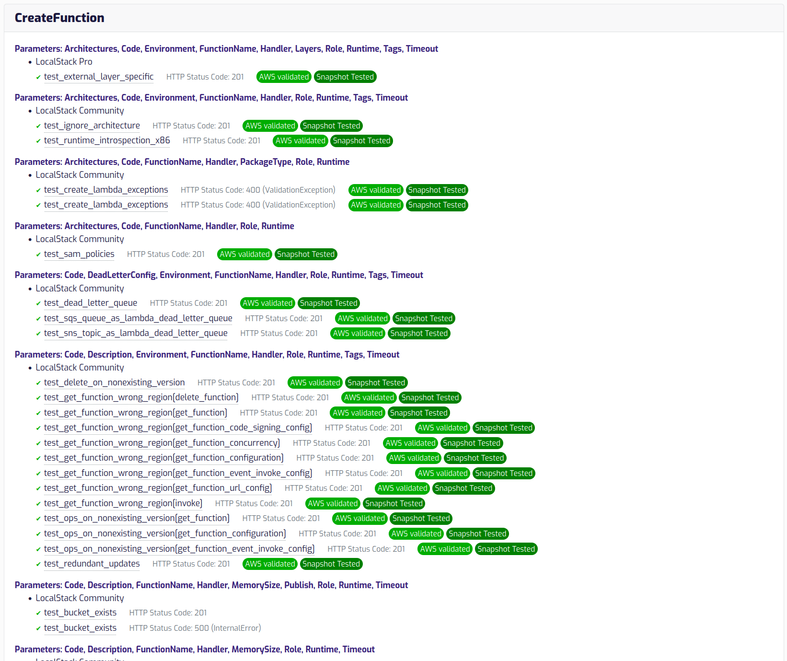

Slide 45

Takeaways
Scaling your team = scaling your codebase
Dynamic code loading
OSS ❤️
Pick your battles
Consider patterns when migrating frameworks
Introspect

Slide 46

Thank You! ❤️

Slide 47



Thomas Rausch
@thrauat
thrau
/in/thrau
Get involved!
https://localstack.cloud

